Slide 1

Glucose in balance
Lesson Four
Today we will…
Model the mechanism of type 2 diabetes
See how homeostasis works to keep the body in balance
Learn about the organs and hormones involved in glucose homeostasis
Learn about the factors that contribute to type 2 diabetes
Notes:
Teacher note: Slides 1 -9 are introductory slides to be shown before the activity begins.

Slide 2
Meet the players
Who’s who of diabetes:
Glucose! Many of the foods we eat are broken down during digestion to this simple sugar. Glucose is carried to every cell in our body by the blood stream, where it is used as the source of energy for our bodies.
In our model, the 6-sided glucose sugar is represented by a round rotelle pasta piece.
The stored form of glucose is called glycogen. Glycogen is made up of many connected units of glucose.
Notes:
In some tissues, insulin is required for glucose to enter the cell.

Slide 3
Meet the players
Who’s who of diabetes:
Insulin! This hormone is released into the blood when blood glucose levels are high. It enables glucose to be transported into the cell in some tissues.
In our model, insulin is represented by a piece of penne pasta (I-shaped)
Glucagon! This hormone is released into the blood when blood glucose levels are low. It enables glucose to be released from some tissues back into the blood stream.
In our model, glucagon is represented by a piece of macaroni pasta (curvy-shaped)

Slide 4
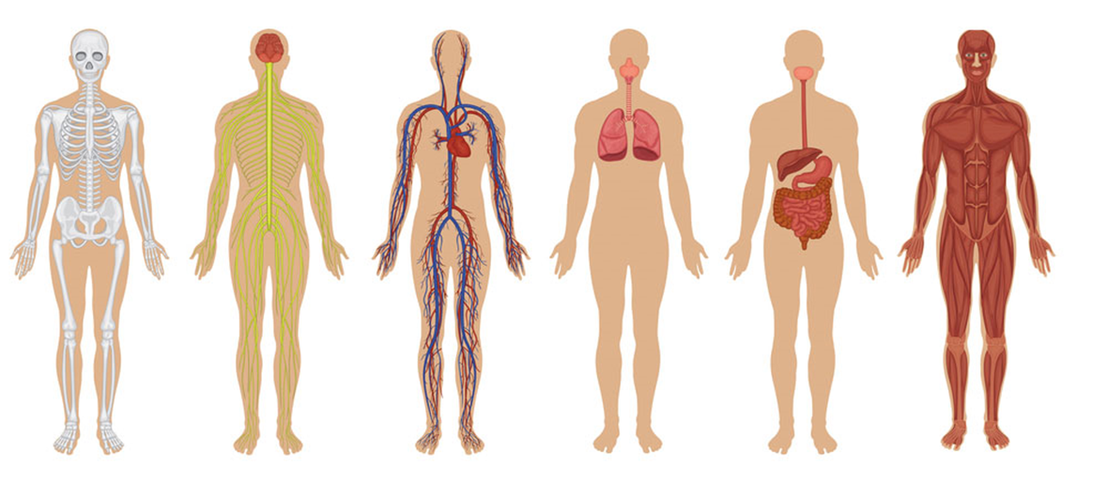
Meet the players
The body organs:
Pancreas: One of the major players in glucose homeostasis, the pancreas releases the hormones, insulin and glucagon, that control blood glucose. The cells in the pancreas that produce insulin are called β (beta) cells.
Liver: This organ takes up glucose when levels are high and releases glucose when levels are low. It stores glucose in chains as glycogen. It is key for glucose regulation.

Slide 5
Meet the players
More body organs:
Muscles: Our muscles are able to take up and store lots of glucose when insulin is present. More muscles mass means more of a reservoir for glucose.
Fat cells: Fat cells take up glucose when insulin is present. Fat cells use glucose to make more fat.
Brain: The brain takes up glucose whenever it needs energy. Glucose is the only fuel the brain can use.

Slide 6
Glucose in balance
Balanced Blood Glucose
Balanced Blood Glucose
Balanced Blood Glucose
All of these systems work together to keep our blood glucose level balanced.
For our model, 3 pasta wheels represent a balanced amount of blood glucose.

Slide 7


Glucose in balance
Blood vessels carry insulin and glucose to cells
High Blood Glucose
Pancreas releases insulin
High blood sugar triggers the pancreas to release insulin

Slide 8
Glucose in balance
Blood vessels carry glucagon to the body to trigger the release of stored glucose back into the blood.
Pancreas releases glucagon
Low Blood Glucose
Low blood sugar triggers the pancreas to release glucagon

Slide 9
Glucose in balance
Balanced Blood Glucose
This balancing act happens many times a day—every time you have a meal or consume a drink with sugar. The ability of the body to maintain balance and regulate internal conditions is called homeostasis.
Notes:
Hand out the game boards and pasta shapes for each group. Tell students that the class will go through 3 different scenarios using the boards.

Slide 10
Glucose in balance
SCENARIO ONE
You have just eaten a meal of pancakes and maple syrup. What happens?
Pour about 15 round pasta pieces into the pan on the balance and tilt the balance.
  What does this do to the blood glucose level? How does the pancreas respond?
  Release 5 insulin into the blood stream.
Insulin is carried to the cells. Place insulin onto each receptor on the liver, fat and muscle.
The insulin/receptor combination activates a channel for the glucose to move into the cell in muscle and fat cells. In the liver, the channel is always active.
Move glucose into the liver, fat and muscle. The muscles are able to take up lots of glucose, so move more glucose into the muscles.
Don’t forget to feed the brain! Without insulin receptors, glucose can move freely into the brain. Give the brain one glucose.
Notes:
The insulin/receptor combination in the liver acts to halt the release of glucose.

Slide 11
Glucose in balance
SCENARIO ONE, continued
You have just eaten a meal of pancakes and maple syrup. What happens?
Continue moving glucose into organs until blood glucose is back to the normal level (3 glucose remain on the balance).
Arrange the glucose in the muscle and liver into chains to represent stored glucose in the form of glycogen.
Once glucose in the blood is decreased, insulin can be removed from the receptors.
This is the end of Scenario One. Keep your board as it is to begin Scenario Two.

Slide 12
Glucose in balance
SCENARIO TWO
You’ve been sitting in school and haven’t eaten in hours! What happens?
Your brain is hungry! Feed it one glucose from the pan on the balance, and move the balance accordingly.
What happens to the blood glucose level?
How does your pancreas respond?
Release 5 glucagon into the blood stream.
Place a glucagon on its receptor on the liver. The glucagon/receptor combination results in glucose being released from the liver by breaking down glycogen.
Move 2 glucose out of the liver into the blood stream.
Your brain needs energy again. Give it another glucose.
End of scenario two. You may clear your board.

Slide 13
Glucose in balance
meal
Insulin levels, uU/mL
Blood glucose levels, mg/dL
120
Glucagon pg/mL
100
80
-60
0
60
120
180
240
Time in minutes
Unger, FH. N Engl J Med. 1971; 285:443-9
Notes:
This slide shows the normal fluctuations in glucose, insulin and glucagon after a meal.

Slide 14
Glucose out of balance
So far, everything we’ve seen has been the body’s healthy response to glucose.
When our bodies are overweight, especially around the middle, our insulin receptors become changed and do not bind insulin as well. This is called insulin resistance and can lead to the development of type 2 diabetes.
SCENARIO THREE
What happens to blood glucose after eating a meal when the body becomes insulin resistant?
Place a small sticky note on each insulin receptor to show that it is insulin resistant.
Pour about 15 round pasta pieces into the pan on the balance.
  What does this do to the blood glucose level? How does the pancreas respond?
  Release 5 insulin into the blood stream.
Notes:
Insulin resistance in fat and muscle cells is influenced by increased levels of fat, particularly visceral fat. The increased lipids affect the pathway in which insulin receptors signal glucose transporters, through which glucose enters the cell.

Slide 15
Glucose out of balance
SCENARIO THREE
The resistant insulin receptors cannot bind insulin at this concentration. Muscle, liver and fat do not take up glucose.
The glucose levels are still high, so the pancreas releases more insulin. Release 5 more insulin into the blood stream.
At this higher insulin level, some insulin receptors bind insulin. Put insulin on some of the receptors.
Liver, fat and muscle can take up some of the glucose in the blood. Put some of the blood glucose into these tissues.
Blood glucose is still high, so the pancreas releases more insulin.
Release 5 more insulin in the blood stream.
More receptors bind insulin.
Put insulin on all its receptors.
Liver, muscle and fat take up more glucose from the bloodstream.
Put more glucose in liver, muscle and fat.

Slide 16
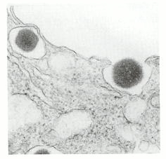
Glucose out of balance
What happened?
Insulin resistance causes the pancreas to work hard all the time. Blood glucose levels are higher than normal after a meal and at a resting state. This stage is called pre-diabetes.
Developing type 2 diabetes
When the β cells in the pancreas are working hard all the time, they eventually become damaged and can only make a small amount, if any, insulin. With low insulin levels, blood glucose levels are always high. At this point, a person is said to have type 2 diabetes.
This electron micrograph shows the release of insulin from a pancreatic β cell. One secretory granule is on the verge of releasing insulin into the extracellular space, and the other has already released the hormone.
[Courtesy of Dr. Lelio Orci. L. Orci, J.-D. Vassalli, and A. Perrelet. Sci. Am. 259 (September 1988):85–94.]

Slide 17
Glucose out of balance
Higher levels of blood glucose can often be brought down with changes in diet and exercise in the pre-diabetes stage.
Once β cells are damaged, however, diabetes becomes a life-long condition that will always require management.
What is one test for diabetes? Measure blood glucose levels.
After fasting for at least 12 hours, a person’s blood is drawn and tested for glucose. A healthy person would have a fasting blood glucose level of about 80-90 mg/dL.
Notes:
Lesson Six will address some of the treatments/medication for type 2 diabetes .

Slide 18
Glucose out of balance
Healthy
Prediabetes
Diabetes
Higher fasting glucose levels indicate increased insulin resistance.
320
Glucose given
Blood glucose levels, mg/dL
240
High glucose following a meal indicates poor insulin output from the pancreas.
160
80
0
10
20
30
40
50
60
Fasting
Time in minutes

Slide 19
What happens if…
Using what you’ve learned, predict what would happen in the following situations:
ONE: The β cells in the pancreas can only produce a very small amount of insulin.
Without adequate insulin, glucose cannot enter the cells and glucose levels continue to rise in the blood.
Excess glucose in the blood binds to proteins, cells and tissues and they no longer work the way they should. This can lead to:
Constant thirst and urination, as the kidneys work hard to get rid of excess glucose. When not treated, this can lead to kidney failure.
Blindness, as the small blood vessels in the back of the eye become broken.
Infection in the toes, legs and feet, caused by poor circulation and a lack of feeling due to nerve damage.
Heart failure as large blood vessels become clogged and small blood vessels become fragile and leaky.

Slide 20
What happens if…
Using what you’ve learned, predict what would happen in the following situations:
TWO: You go from a sedentary lifestyle to one that includes daily exercise.
(Hint: Muscles can take in about five times as much glucose as liver and fat can. Muscles also burn glucose for energy.)
Regular activity can lower blood glucose levels. Muscles can use their own stored glycogen as energy, as well as taking in glucose from the blood. When glucose levels are low, the liver can also release stored glycogen as glucose for the muscles to use.
Exercise lowers blood glucose levels in the following ways:
Building muscle provides more mass to store and use blood glucose.
When you are active, cells become more sensitive to insulin so it can work more efficiently; in other words, insulin resistance decreases.
Burning calories through exercise also helps maintain or decrease weight, which are important factors in type 2 diabetes.
Notes:
Muscles can also burn fat as a source of energy, as well as glucose.

Slide 21
What happens if…
Using what you’ve learned, predict what would happen in the following situations:
THREE: You have been diagnosed with type 2 diabetes and have been prescribed the drug Metformin. (Hint: Metformin acts to lower glucose production in the liver, and increase insulin sensitivity in the muscles.)
By lowering glucose production in the liver, glucose released by the liver won’t add to already high levels of blood glucose. In addition, the muscles will be able to better utilize the insulin in the blood--sort of like removing some of the sticky notes from the insulin receptors.
Other drug treatments for type 2 diabetes include:
Insulin injections when the β cells can no longer produce enough insulin.
Drugs that increase insulin production in the remaining functional β cells.
Drugs that slow the digestion of starches to glucose and/or slow the emptying of the stomach in order to lessen sudden spikes of glucose in the blood.
Notes:
Muscles can also use fat for energy, in addition to glucose.

Slide 22
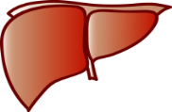
Contributions to type 2 diabetes
Insulin Resistance
in organs and tissues
Decreased Insulin Production
in the pancreas
Elevated Blood Sugar
=
PREDIABETES
TYPE 2 DIABETES
Notes:
Point out for students that the first arrows are bi-directional—a person can work to control elevated blood sugar and prediabetes

