Slide 1
Contributions to Type 2 Diabetes

Slide 2
Glucose in balance
meal
Insulin levels, uU/mL
Blood glucose levels, mg/dL
120
Glucagon pg/mL
100
80
-60
0
60
120
180
240
Time in minutes
Unger, FH. N Engl J Med. 1971; 285:443-9
Notes:
This slide shows the normal fluctuations in glucose, insulin and glucagon after a meal.

Slide 3
Oral Glucose Tolerance Test
Blood Glucose levels (mg/dl)
Glucose given
Blood Insulin levels (µU/ml)
300
140
250
120
200
100
80
150
60
100
Healthy (n=240)
40
50
Prediabetes (n=191)
20
Diabetes (n=100)
0
0
0
20
40
60
80
100
120
0
20
40
60
80
100
120
Fasting
Time (min)
Time (min)
Jensen CC et al: Diabetes 51:2170-2178; 2002
Notes:
Point out for students that the fasting blood glucose levels are different for each of the three conditions, even before glucose is given.
The data are from people who are first degree relatives (parent, siblings, and/or children).

Slide 4
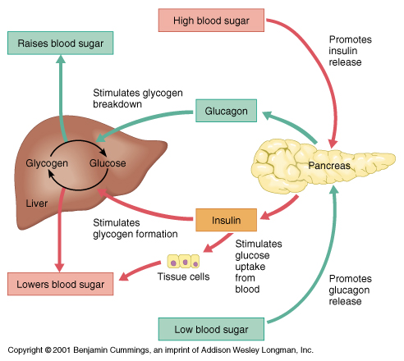
Glucose in balance
Notes:
Follow the red arrows to see how high blood sugar is balanced, and green arrows to see how low blood sugar is balanced

Slide 5
Glucose in balance
http://www.medscape.org/viewarticle/551055
Notes:
Postprandial – after a meal

Slide 6
Glucose in balance
FPG – Fasting Plasma Glucose
N –
Number of people in that group

Slide 7
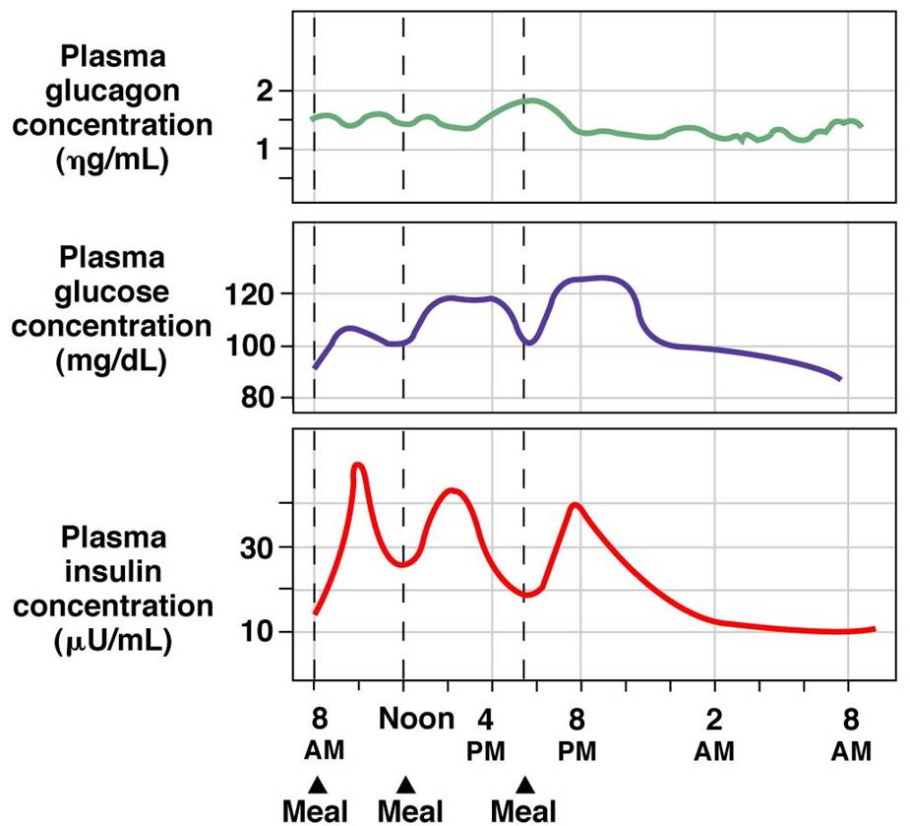
Glucose in balance
Notes:
http://www.austincc.edu/apreview/EmphasisItems/Glucose_regulation.html
Looking at levels over a whole day

Slide 8
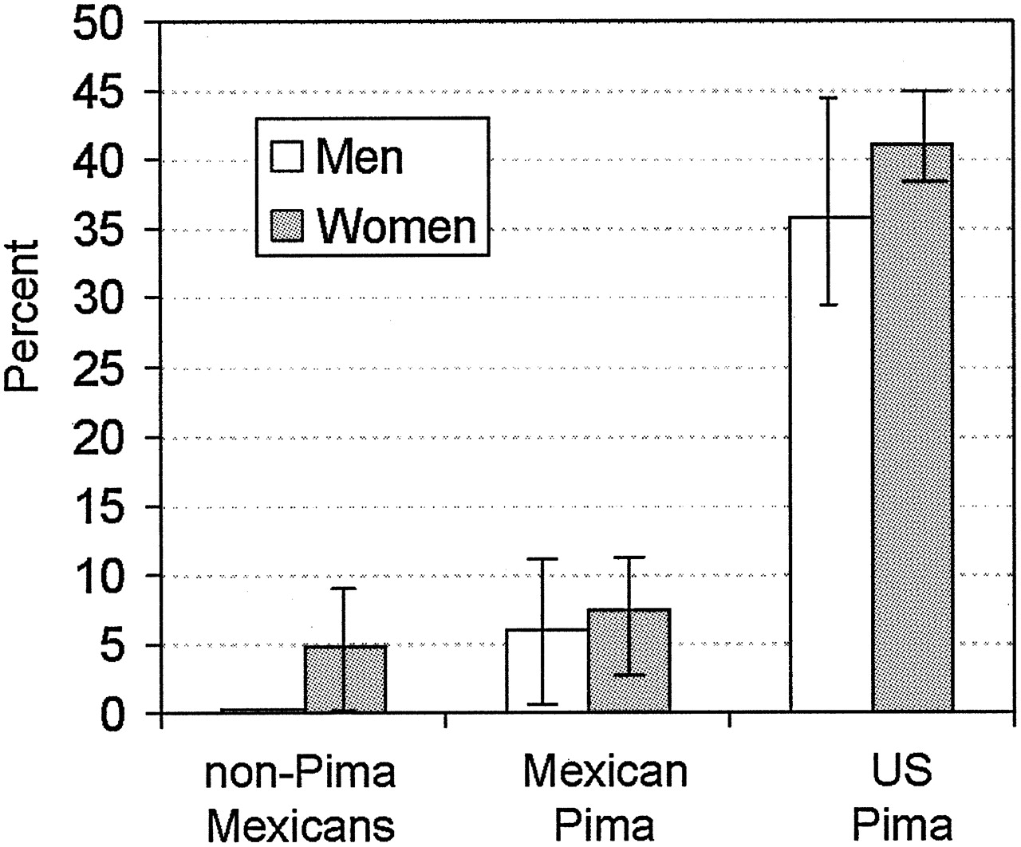
Diabetes incidence in three populations
Schulz L O et al. Dia Care 2006;29:1866-1871
Notes:
Slide on left shows development of insulin resistance in people who still have normal blood glucose levels. Could be used to discuss development of insulin resistance under two environmental conditions.
Slide is useful in discussing genetic/environmental aspects of t2d in Pimas
These slides could be used in conjunction with segment from Unnatural causes showing Pima lifestyle in Mexico and USA and asking about environmental/lifestyle factors that might explain the differences.

Slide 9
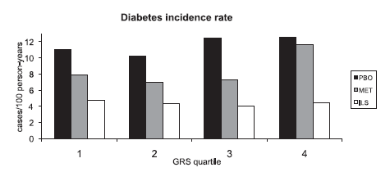
Diabetes Prevention Program Data
Cases/100 persons-years
Diabetes incidence rate
Placebo
Metformin
Lifestyle changes
Genetic risk group
Lowest Genetic Highest Genetic
Risk Risk
Jablonski K A et al. Diabetes 2010;59:2672-2681
Copyright © 2011 American Diabetes Association, Inc.
Notes:
The Diabetes Prevention Program (DPP) is a long-term research study that compares people who are pre-diabetic with other people who have a normal risk for developing type 2 diabetes.

Slide 10
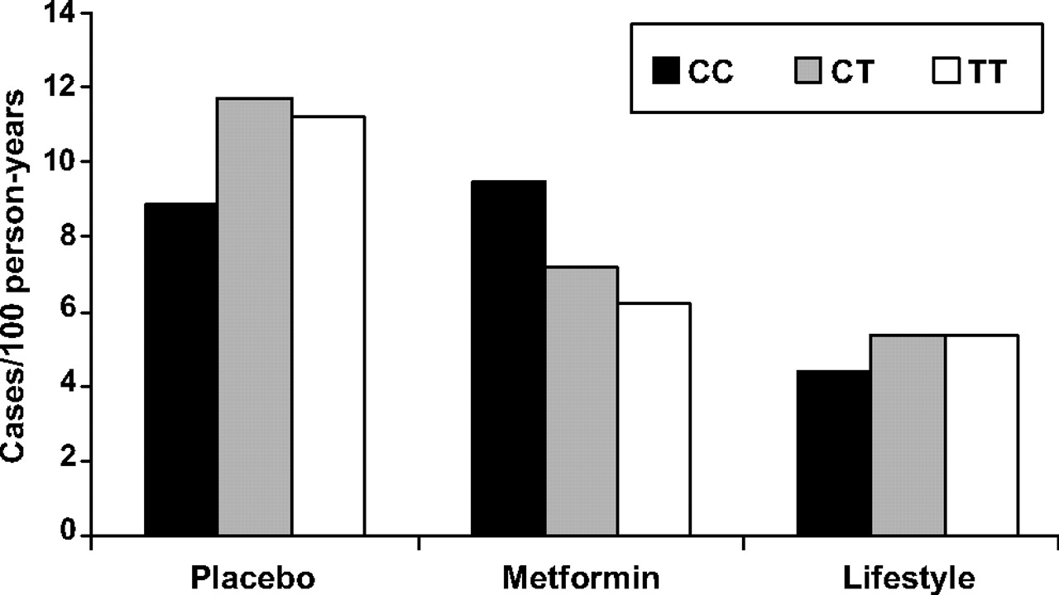
Diabetes Prevention Program Data
Allele combinations:
Jablonski K A et al. Diabetes 2010;59:2672-2681
Copyright © 2011 American Diabetes Association, Inc.
Notes:
Scientists are studying the gene alleles that increase the likelihood that a person will develop type 2 diabetes (risk alleles). The alleles at the location in question come in three combinations: CC, CT, and TT.
Note: People all have the same genes, but the genes of any two people are slightly different. This is why no two people are exactly the same. The different forms of a gene are called alleles.

