Slide 1
Participating in the GEMNet study as a Teacher: Implementing & Evaluating Curricula for Type 2 Diabetes (t2d) in Health and Biology Classes
Notes:
Thank you for considering participating in the GEMNet study. The purpose of this slide show is to orient you to your roles and responsibilities as part of our project to implement and evaluate new curricula for Type 2 Diabetes

Slide 2
GEMNet Team
Joan Griswold, MIT
GEMNet Principal Investigator
Genome Sciences
Helene Starks, PhD MPH
Co-Principal Investigator
Bioethics & Humanities
Project Information
Title: GEMNet: A cross-disciplinary approach to teaching about type 2 diabetes
NIH funding from the SEPA program in the Office of the Director
Grant Number R25OD21869 Project period: 08/04/17 – 07/31/22
Notes:
We are Joan Griswold, and Helene Starks, of the University of WA Genome Sciences Education Outreach group
This presentation will tell you about GEMNet (Genes, the Environment and Me: A Health and STEM Network), which is a 5 year project that develops, teaches and evaluates linked curricula on type 2 diabetes to be taught in health and science classes. Each curriculum is designed with class-specific content and is intended to take about 7-10 days to teach.
This slide has all the details about the project title and funding should you need it. We are always grateful to acknowledge funding from the SEPA program at the NIH.

Slide 3
Age-adjusted Prevalence of Diagnosed Diabetes Among US Adults
1994
2000
2015
No Data <4.5% 4.5%–5.9% 6.0%–7.4% 7.5%–8.9% >9.0%
CDC’s Division of Diabetes Translation. United States Surveillance System available at http://www.cdc.gov/diabetes/data
Notes:
Why is type 2 diabetes education important? The rapid and recent increase in type 2 diabetes in the US provides a compelling phenomenon that links concepts taught in both biology and health classes. This topic builds a bridge between biological concepts such as homeostasis and gene/environment interactions and health concepts such as nutrition, label-literacy and disease prevention. The topic also connects to broader social issues, including environmental influences, health care, personal choice, and public policy. For most people, type 2 diabetes takes years to develop, and is a highly preventable condition. For high school students who are at a tipping point of making their own decisions around food, we hope that they can begin their adult lives with an understanding of why healthy choices matter.

Slide 4
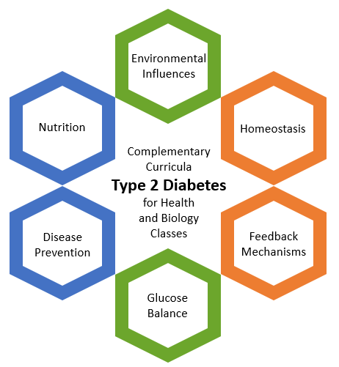
How do we address type 2 diabetes?
Health Classes Shared Concepts Biology Classes
Notes:
What have we built? Genome Sciences Education Outreach (GSEO) at the University of Washington is conducting an educational program focused on teaching about type 2 diabetes in 9th and 10th grade high school health and general biology courses (the GEMNet study). We worked with teachers to develop and pilot the complementary health and biology units and a pre- and post-test designed to measure student learning.
Building on prior grant-funded work, the two complementary curriculum modules share one set of Enduring Understandings. These concepts are taught in ways that support standards for both biology and health classes.

Slide 5
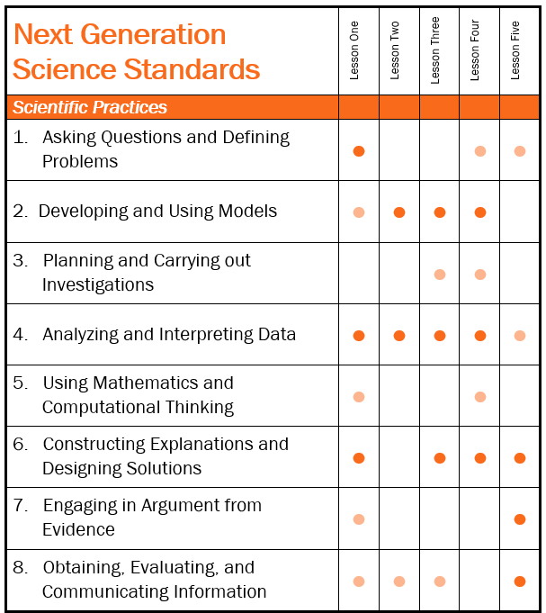
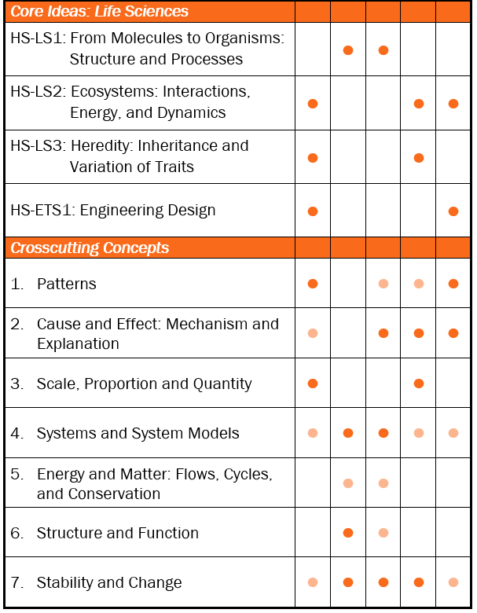
Biology Unit
Notes:
The 5-lesson biology curriculum was built using 3 dimensional instructional practices which support the Next Generation Science Standards. The unit is phenomenon-driven, scientifically accurate, and exposes students to a complex, real-world problem that is in need of solutions. In each lesson, students use science and engineering practices and apply crosscutting concepts to support a deep understanding of the various life-science disciplinary core ideas. Lends itself to Ambitious Science Teaching practices, if teachers are using that framework.

Slide 6
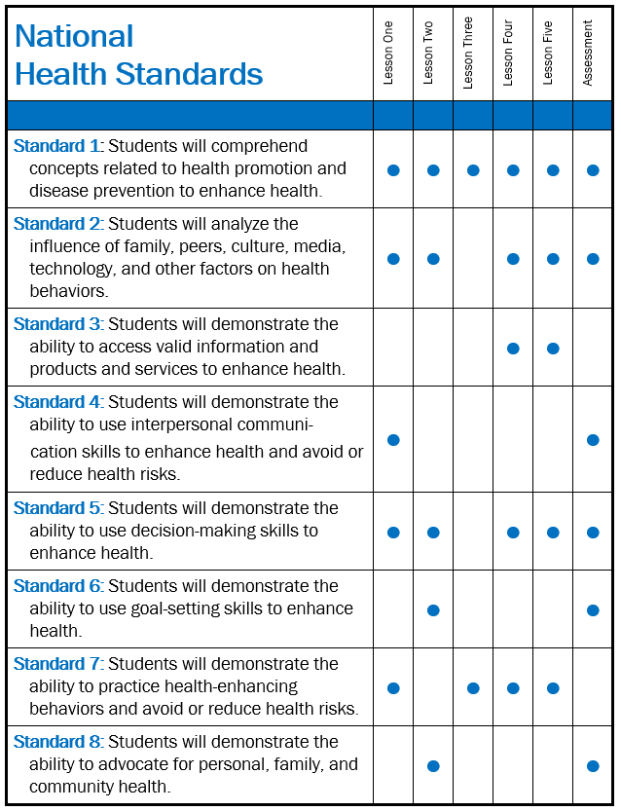
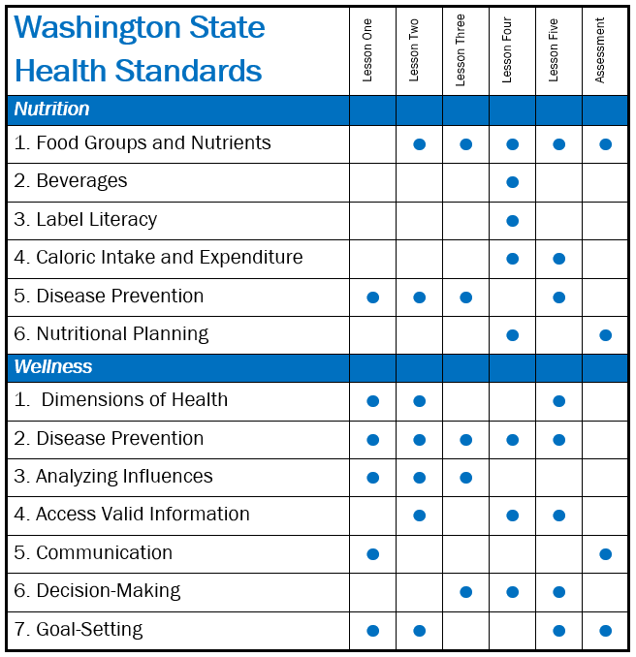
Health Unit
Notes:
In using the 5-lesson health unit, which is accompanied by as assessment piece, teacher can address every nutrition and wellness standard in WA state, which also supports student understanding of the National Health Standards.

Slide 7
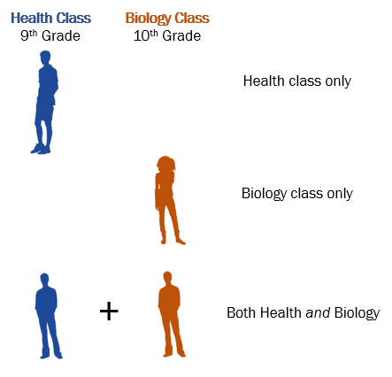
The GEMNet research study
Notes:
We have developed two sister units to teach about t2d,, one for health class and one for biology class. They two units share some of the same concepts and lessons, but also have lessons created specifically for each class.
We want to know
How well each unit works to teach the concepts in health OR biology,
The impact for individual students who may learn about diabetes in both health and biology classes, even if one class is a year later.
What students take away that they can use in their personal and family life

Slide 8
We are looking for…
Health and biology teachers interested in
Incorporating type 2 diabetes lessons into their classes
Participating in a research study
We are particularly interested in identifying teams of health and biology teachers from the same school
though we are happy to have you if you don’t have a teacher to partner with.
Notes:
We are looking for health and biology teachers who are interested in incorporating type 2 diabetes lessons into their classes and participating in a research study that measures how well their students understand the type 2 diabetes-related science and health content. We are particularly interested in identifying teams of health and biology teachers from the same school, although individual health or biology teachers are also welcome to participate on their own.
This Photo by Unknown Author is licensed under CC BY-NC

Slide 9
Scheduling the baseline control group
All students participate as part of regular class activities
Pre-test
(~ 20 min)
“business-as-usual” curriculum
(~1-2 weeks)
Post-test
(~ 20 min)
Everyone in class takes the pre-test
Health
(9th grade)
Biology
(10th grade)
Everyone in class takes the post-test
Notes:
Before teaching the diabetes unit, we would gather baseline data from a group of students who DO NOT receive the curriculum.

Slide 10
Treatment group
All students participate as part of regular class activities
Pre-test
(~ 20 min)
Type 2 Diabetes Curriculum
(~1-2 weeks)
Post-test
(~ 20 min)
Everyone in class takes the pre-test
Teacher may use to show learning gains pre-post
Health
Environmental influences
Nutrition
Disease prevention
Glucose balance
(9th grade)
Biology
Environmental influences
Homeostasis
Feedback mechanisms
Glucose balance
(10th grade)
Everyone in class takes the post-test
Teacher may use for grading purposes
Notes:
With a new groups of students (the following semester or the following school year), teachers would teach the curriculum, book-ended by the pre and post test.

Slide 11
Compensation & benefits
Teachers receive $75 per class for completed pre/post data sets
Teachers receive student test scores to use as a class grade
Compensation for attending professional development (PD) sessions at $25/hour plus STEM clock hours
Travel and housing compensation to attend PD for qualifying teachers
Consideration for curriculum design teams and as workshop co-presenters, if interested

Slide 12
Study Participant Expectations
Read, sign & return Study Teacher Consent Form
Schedule your timing for the study (collection of baseline data + research study data)
Attend a professional development workshop about the curriculum before teaching the curriculum
Tell students about the study and the pre/post-test as part of the class evaluation
Show GEMNet consenting video to students
Administer pre/post-tests
Teach GEMNet unit for your discipline as written

Slide 13
Thank you!
If you have further questions, please email or call
Joan Griswold, MIT
jcgriz@uw.edu
GEMNet Principal Investigator
Genome Sciences, Box 355065
University of Washington
Foege Building, Room S-334
Seattle, WA 98195-5065
P 206 616-4538
C 425 241-3081
https://gsoutreach.gs.washington.edu/
Notes:
Thanks again for all your help with the project. We really appreciate it!

